Slide 1
Data Structure and
Algorithm Design
Computer College , Beijing Institute of Technology
Zhong Hong(钟宏）
zhongh@vip.sina.com
Notes:
Good morinig, welcome to my class,first let introduce myself,

Slide 2
Objective
Data Structures
Applications
Algorithms
Data Abstraction
C Programming
English
Notes:
Before we go into the detail of data struct, we should have look the obj of this course

Slide 3
Data Structures
LIST
SET
TREE
GRAPH
Notes:
The main purpose of this course is studying data structures, eg.list,stack,queue,tree,the ways how to represent them in computer, how to design them, how to implement them.

Slide 4
Applications
Leverl
A
0
B1
C1
D2
1
E1
F2
M10
F1
G1
2
最终产品：A； 装配件：B、D
标准件：E、F、G；自制件：C； 材料：M
Notes:
When we study data structures, we must learn how to use them in applications. Because Data structures represent data in applications(eg. ERP, BOM)

Slide 5
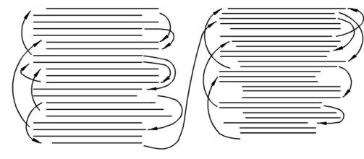
Algorithms
Greedy Algorithms
Divide and Conquer
Backtracking Algorithms
Game Play
Data Searching
Sorting
Shortest Path
Critical Path
Network Flow
Euler Circuits
….
Notes:
Applictions are implemented by programs, these programs are written according to algorithms. So we should learn many algorithms(eg. Expression eval, critical path, flow control) to see how data structures are used in applications.

Slide 6

Data Abstraction
Abstract Data Type
Abstraction in hardware
  computers-boards-chips-…
Abstraction in network
  http-tcp-ip-link-…
Abstraction in software
  system-services-components-object
Notes:
Data Abstraction is a very important technique we will learn in this course. Abstraction get main features and hide detail. Abstraction actually is very important technique in computer science.In hardware, a system consists of many computers, a computer is built by many modules(eg. A computer is built by many boards, a board is built by many chip. A software, a system have many subsystems, a subsystem provide many services, a services may have many components, a components may have many objects.

Slide 7
C programming
typedef
pointer
function library
developing enviroment
recursive
….
Notes:
In this course, we use C as programming language, the programs or algorithms are much complicated than you met in other courses, you will learn many new programming techniques in this course(eg. recursive, typedef,pointer).

Slide 8
English
Listening
Reading
Writing
….
Notes:
This course are taught in bi-language, I will try to speak english in most time, but sometime I will use chinese
When I speak chinese,:
Something difficult to understand
Something important
I am tired of speaking english

Slide 9
Approach
Lectures
Demos
Readings
Practices
Notes:
You learn most of this course from lectures
I will show many real programs, how they write, how they run
You need read book in your spare time to review or prepare
Practices are very important for this course, we have lot of practices, your final grading depends on practices heavily

Slide 10
Final Grade
Exam ( 70%)
Execises, Homework and Attendance Rate(10%)
Experiments(80points, 20%)

Slide 11
Schedule
Lectures: 40 hrs
Execises, Experiments

Slide 12
Reference
Data Structure and Algorithm Analysis in C（Second Edition)
  Mark Allen Weiss
数据结构（C语言版）
  严蔚敏，吴伟民
  清华大学出版社
Data Structure with C++
  William Ford,William Topp
Notes:
Our textbook is 1st one, our lectures are organized according this book
But second is very important reference book, because other classes use these book, we need keep something common with them.beside,our textbook concentrate on algorithm design and analysis, it lack programming detail, we need this book as complement.
We use some idea from 3rd book

Slide 13
What is Data Structure
Data Set + Relations + Operations
Niklaus Wirth：
  Algorithm + Data Structures = Programs (1985)
Notes:
A data structure usually has 3 main parts,
Data set contains lot of data elements(eg. BOM), there are some relations among these elements, we use them by some basic operations.
Niklaus Wirth a very famous computer expert, he write a book “Algorithm + Data Structures = Programs”, this book become standard textbook of data structure, contents of many textbooks we used today are come from this book.
What does this equation means? When we write programs in an application, we must think how to represent data of the application in computer, that means we must design data structure 1st. we then must consider how to write programs, which operate on data structures, to solve problems, that means we must design algorithms.

Slide 14
Two Aspects of Data Structure
Logic(Abstract) Descrption
Physical implementation
Notes:
So when we design or learn a data structure, two things should be done. Logic description consider what data contained in data structure, what relation between data, how to use them. Phycical implementation consider how to represent data and relations in computer, how to implement them.

Slide 15

Example:
Orders Matching
(price of buy order >= price of sell order)
Stock Exchange Center
orders
Broker
Broker
Broker
Broker
orders
orders
orders
orders
Agent
Agent
Agent
Agent
Agent
Agent
Agent
Agent
Agent
Agent
Agent
Agent
Order: stockid, price, quantity, b/s
Notes:
Here is a stock trading system, some of your family may be stockowner, usually we go to some stock agent to buy or sell stock(now we can do it on internet, but it still go through agent), we send our trading request, which is called order(what it contains), to agent, agents belong to broker, it forward our orders to broker, broker send order to exchange center.
In exchange center there is an orders matching system, which try to match buy orders and sell orders, two orders(one is buy order and another is sell order) are matched when price of buy order >= price of sell order,

Slide 16
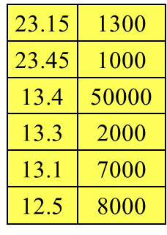
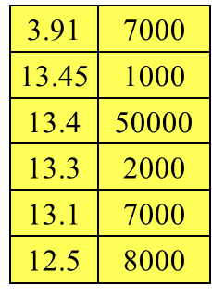
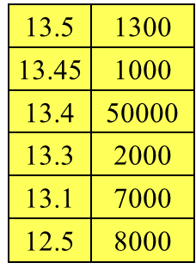
Order Queues
Stock Exchange System
Matching
Process
Querying
Process
Buy
Sell
23.84
50000
4.19
9000
13.55
1000
13.54
2000
33.55
1000
13.64
50000
13.55
1000
33.64
50000
13.73
2000
13.64
50000
33.73
2000
QuotationProcess
13.81
7000
13.73
2000
23.81
7000
13.81
7000
price qty
price qty
Deleting
Process

Slide 17
Order Queue Data Structure
Data Set: Uncompleted Orders
Relation: Ordered by Price and Time
Operations:
  InsertOrder
  GetFirstOrder
  DeleteOrder
Notes:
Most of orders will not be matched, we must keep them in the queues. Each stock has two queue, one is for buy queue, another is sell queue

Slide 18
Order Queue(Link)
Buy
13.5
2000
Sell
13.54
2000
13.45
1000
13.55
1000
13.4
50000
13.64
50000
13.3
2000
13.73
2000
13.1
7000
13.81
7000
12.5
8000
price qty
price qty

Slide 19
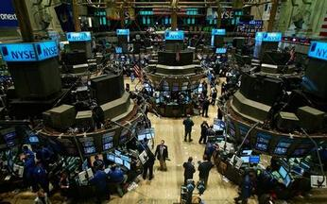
Simulation Program
Notes:
Most of orders will not be matched, we must keep them in the queues. Each stock has two queue, one is for buy queue, another is sell queue

